Slide 1
ECMAScript Quick Start Day02
Axle Barr
Bootcamp

Slide 2

AGENDA
Day 1
Promisses
Notes:
Day 1:
Tool: IDE
Conventions
List comprenensions (unique to Python)

Slide 3
Synchronous/Asynchronous code
Function A
Function B
Function C

Slide 4
Synchronous/Asynchronous code
Function A
We still don’t have data at this point, but it will come eventually
Function B
Normal return
Function C
Promise
object
www

Slide 5
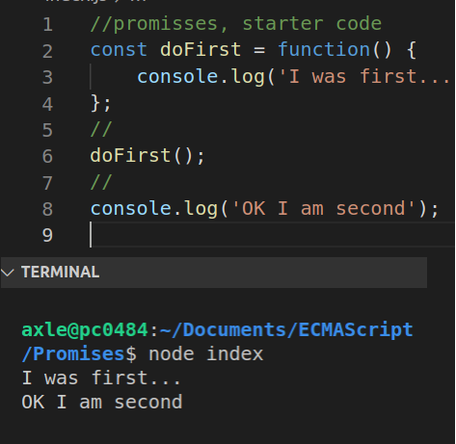
Interrupting the sequence
Normal sequence, first…second..
Notes:
Graphics:
On click the callout appears

Slide 6
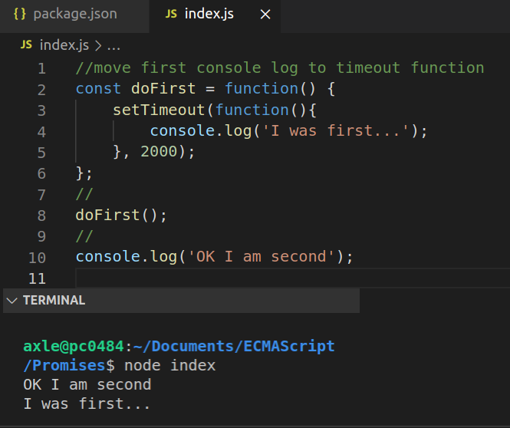
Interrupting the sequence
The setTimeout() function has caused line 10 to execute first, NOT what we want
Notes:
Graphics:
On click the callout appears

Slide 7
Introduce the Promise
//promisses
const doFirst = function() {
return new Promise();
setTimeout(function(){
console.log('I was first...’);
}, 2000);
};
//
doFirst();
//
console.log('OK I am second');
Lets create a Promise object

Slide 8
Introduce the Promise
//promisses
const doFirst = function() {
return new Promise(function(){
//promise returned here
});
setTimeout(function(){
console.log('I was first...');
}, 2000);
};
//
doFirst();
//
console.log('OK I am second');
The constructor of the Promise takes a function that will return the actual promise object

Slide 9
Introduce the Promise
//promisses
const doFirst = function() {
return new Promise(function(resolve, reject){
//promise returned here
});
setTimeout(function(){
console.log('I was first...');
}, 2000);
};
//
doFirst();
//
console.log('OK I am second');
The Promise function itself takes two parameters.
The first parameter will handle the positive of the doFirst() function and the second will handle any errors or rejection of the doFirst function()

Slide 10
Introduce the Promise
//promisses
const doFirst = function() {
return new Promise(function(resolve, reject){
setTimeout(function(){
console.log('I was first...');
}, 2000);
});
};
//
doFirst();
//
console.log('OK I am second');
On the positive side when the resolve happens, we want something to happen, we want to pass some data out of the function, so wrap the setTimeout() function with this Promise:

Slide 11
Introduce the Promise
//promisses
const doFirst = function() {
return new Promise(function(resolve, reject){
setTimeout(function(){
resolve('I was first...');
}, 2000);
});
};
//
doFirst();
//
console.log('OK I am second');
Instead of logging the data, resolve the data.
It will be logged later when the doFirst() function is called

Slide 12
Introduce the Promise
//promisses
const doFirst = function() {
return new Promise(function(resolve, reject){
setTimeout(function(){
resolve('I was first...');
}, 2000);
});
};
//
console.log(doFirst());
//
console.log('OK I am second');
Here we are logging the return from the doFirst() function, which if resolved will print the line:
I was first…
If you run this code you will not get the sentence, you will get a promise.
We need to some more work to extract the sentence (data) from the Promise

Slide 13
Introduce the Promise
//promisses
const doFirst = function() {
return new Promise(function(resolve, reject){
setTimeout(function(){
resolve('I was first...');
}, 2000);
});
};
//
doFirst().then();
//
console.log('OK I am second');
According to the documentation, in order to handle a promise object, you need to chain on a then() method and handle it from there.
Note: this is a common way to get the data, there are other ways

Slide 14
Introduce the Promise
//promisses
const doFirst = function() {
return new Promise(function(resolve, reject){
setTimeout(function(){
resolve('I was first...');
}, 2000);
});
};
//
doFirst().then(function(data){
console.log(data)
});
//
console.log('OK I am second');
The chained then() method takes a parameter which must be a function.
The function inside of the then() method takes a parameter that acts like a bucket to catch anything thrown by the Promise object, so add a parameter in here that would catch the data AND log it for now.
At this point, we still have not solved the sequencing problem, the second line still appears first.
Solving this problem means moving the second line below the return from the promise. See next slide.

Slide 15
Introduce the Promise
//promisses
const doFirst = function() {
return new Promise(function(resolve, reject){
setTimeout(function(){
resolve('I was first...');
}, 2000);
});
};
//
doFirst().then(function(data){
console.log(data) console.log('OK I am second');
});
//
Now the sequence is back to the way it was intended.
Both lines appear 2 seconds later, but the sequence is preserved.

Slide 16
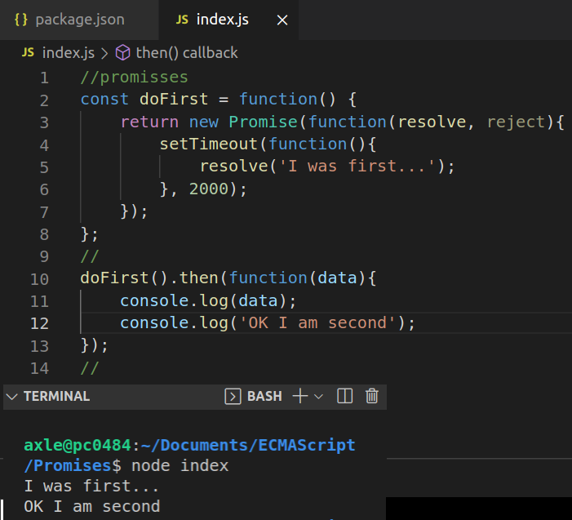
Interrupting the sequence
Back to the original sequence, 2 seconds later but in the correct order

Slide 17
Real world example
At your terminal window, run the following command to install node-fetch: npm install node-fetch
After running the command above, you will get a new folder called node_modules, this folder will contain the node-fetch module that we will import and use
Your package.json file will also change to reflect the installation we just did, but that is not important for this bootcamp

Slide 18
Real world example
Remove all the code from index.js and add in the following code:
import fetch from "node-fetch";
function getData(){
fetch('https://jsonplaceholder.typicode.com/posts')
.then((response) => response.json())
.then((json) => console.log(json));
};
//
getData();

Slide 19
Error Handling
…
const doFirst = function() {
return new Promise(function(resolve, reject){
setTimeout(function(){
//resolve('I was first...');
reject('error...');
}, 2000);
});
};
//
doFirst().then(function(data){
console.log(data);
console.log('OK I am second');
});
…
What if the promise was rejected?
This code cannot handle a rejection

Slide 20
Error Handling
…
setTimeout(function(){
//resolve('I was first...');
reject('error...');
}, 2000);
});
};
//
doFirst()
.then(function(data){
console.log(data);
console.log('OK I am second');
})
.catch(function(err){
console.log(err);
});
…
Add a catch() function to handle any errors
Note: the then function was moved lower but was not changed

Slide 21
ECMAScript 2018
…
doFirst()
.then(function(data){
console.log(data);
console.log('OK I am second');
})
.catch(function(err){
console.log(err);
}).finally(function(){
console.log("Promise was settled");
});
…
ECMAScript 2018 introduced the finally function for clean up purposes

